Slide 1
Lecture 15
Understanding Harmony in Nature
Interconnectedness, Self-regulation and Mutual Fulfillment among the Four Orders of Nature

Slide 2
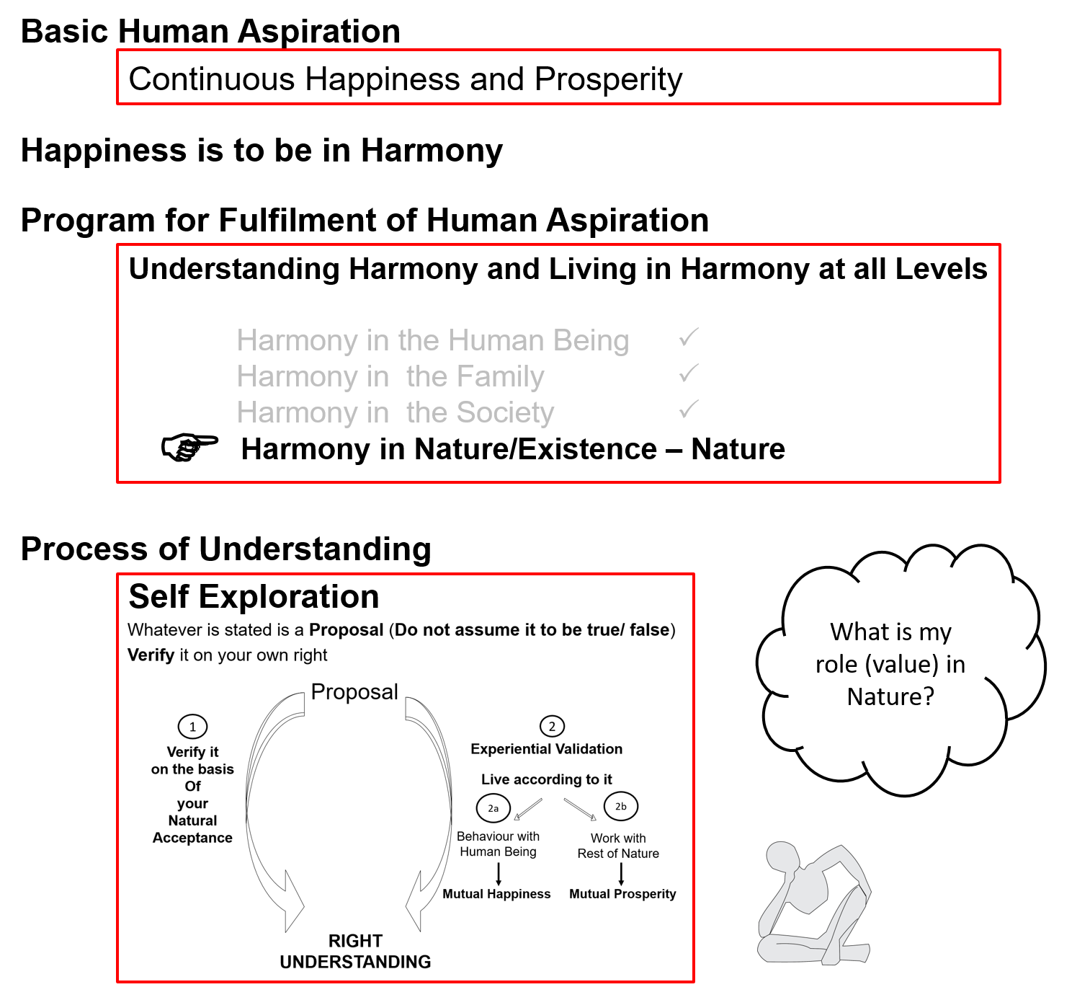

Slide 3
Introduction
So far we have explored our Natural Acceptance
Our Natural Acceptance is for living in Harmony – as an Individual, as a Family, as a Society…
Is there provision in Nature/Existence for living in accordance with our Natural Acceptance?
Is it possible to live in harmony as an Individual, as a Family, as a Society…?
Is co-existence, mutual fulfillment inherent in Nature?
Or
Is the design of nature/existence by way of opposition, struggle, survival of the fittest…?
We will explore the underlying design of Nature/Existence with these questions…

Slide 4
Nature = Collection of Units
Air
Water Trees
Soil
Animal body
Birds Animals Human body
Self(I)
Human Beings
Earth Sun
Moon Metals

Slide 5
Nature = Collection of Units = 4 Orders
All units can be categorised into 4 orders
Bio Order
Plants, Trees
izk.k voLFkk
isM+] ikS/ks
Physical Order
Soil, Metal
inkFkZ voLFkk
feV~Vh] /kkrq
Animal Order
Animals, Birds
tho voLFkk
i”kq+] i{kh
Human Order
Human Being
Kku voLFkk
euq’;

Slide 6
Relationship of Mutual Fulfillment ijLij iwjdrk dk laca/k
Between Physical Order and Bio Order
Interconnected, Interdependent
Mutual Fulfillment
Cyclic
Every unit is enriched
Mutual Fulfillment = Relatedness + Fulfillment
ijLij iwjdrk = ijLijrk + iwjdrk
Bio Order
Plants, Trees
izk.k voLFkk
isM+] ikS/ks
Physical Order
Soil, Metal
inkFkZ voLFkk
feV~Vh] /kkrq

Slide 7
Relationship of Mutual Fulfillment ijLij iwjdrk dk laca/k
Between Physical Order, Bio Order and Animal Order
Interconnected, Interdependent
Mutual Fulfillment
Cyclic
Every unit is enriched
Bio Order
Plants, Trees
izk.k voLFkk
isM+] ikS/ks
Physical Order
Soil, Metal
inkFkZ voLFkk
feV~Vh] /kkrq
Animal Order
Animals, Birds
tho voLFkk
i”kq+] i{kh

Slide 8
Relationship of Mutual Fulfillment ijLij iwjdrk dk laca/k
Physical Order, Bio Order and Animal Order are enriching for Human Order, but Human Order (without right understanding) is not fulfilling for any of the 4 orders
Human beings have
natural acceptance
to be mutually fulfilling
Once human beings understand,
they can be fulfilling for all four orders
Bio Order
Plants, Trees
izk.k voLFkk
isM+] ikS/ks
Physical Order
Soil, Metal
inkFkZ voLFkk
feV~Vh] /kkrq
Animal Order
Animals, Birds
tho voLFkk
i”kq+] i{kh
√
?
√
?
√
?
Human Order
Human Being
Kku voLFkk
euq’;

Slide 9
Present-day Problems are largely due to Lack of Understanding
Resource Depletion – The resource is used at a rate which is faster than the rate at which it is produced in nature
lalk/ku vHkko & mRiknu esa iz;qDr laalk/ku dh xfr] mlds izÑfr esa iSnk gksus dh xfr ls T;knk gS
Pollution – The product is such that
  It does not return to the cycle in nature or
  It is produced at a rate that is faster than the rate at which it can return to the cycle in nature
iznw’k.k & mRiknu ,slk gS fd
  1- mRikfnr oLrq pØ esa okil ugha vkrh ;k
  2- mRiknu dh xfr izkÑfrd pØz esa okil tkus dh xfr ls T;knk gS

Slide 10
Details of the Four Orders
ORDERS 4 voLFkk | UNITS bdkbZ | ACTIVITY fØz;k | INNATENESS /kkj.kk (Self-organisation) | INHERITANCE vuq’kaxh;rk
Physical inkFkZ | Soil, Metal feV~Vh] /kkrq | Formation-Deformation jpuk&fojpuk | Existence vfLrRo | Constitution based Ikfj.kke vuq’kaxh
Bio izk.k | Plants, Trees isM+] ikS/ks | "-“ + Respiration “olu&iz”olu | " + Growth iqf’V | Seed based cht vuq’kaxh
Animal tho | Animals, Birds i”kq] i{kh | "-“, " in Body “kjhj esa Selecting-Tasting in I p;u@vkLoknu eSa esa | ", " in Body “kjhj esa Will to live in I eSa esa Tkhus dh vk”kk | Breed based oa”k vuq’kaxh
Human Kku | Human Beings euq’; | "-“, " in Body “kjhj esa Imaging, Analysing-Comparing, Selecting-Tasting in I fp=.k] fo'ys’k.k] p;u-vkLoknu eSa esa Potential for Understanding in I le>us dh {kerk eSa esa | ", " in Body “kjhj esa Will to live with continuous happiness in I eSa esa fujarj Lkq[kiwoZd Tkhus dh vk”kk Right Feeling lek/kku Right Understanding Kku | Education-Sanskar based f”k{kk&laLdkj vuq’kaxh
Lo;a esa O;oLFkk

Slide 11
Details of the Four Orders
ORDERS 4 voLFkk | UNITS bdkbZ | ACTIVITY fØz;k | INNATENESS /kkj.kk (Self-organisation) | INHERITANCE vuq’kaxh;rk
Physical inkFkZ | Soil, Metal feV~Vh] /kkrq | Formation-Deformation jpuk&fojpuk | Existence vfLrRo | Constitution based Ikfj.kke vuq’kaxh
Bio izk.k | Plants, Trees isM+] ikS/ks | "-“ + Respiration “olu&iz”olu | " + Growth iqf’V | Seed based cht vuq’kaxh
Animal tho | Animals, Birds i”kq] i{kh | "-“, " in Body “kjhj esa Selecting-Tasting in I p;u@vkLoknu eSa esa | ", " in Body “kjhj esa Will to live in I eSa esa Tkhus dh vk”kk | Breed based oa”k vuq’kaxh
Human Kku | Human Beings euq’; | "-“, " in Body “kjhj esa Imaging, Analysing-Comparing, Selecting-Tasting in I fp=.k] fo'ys’k.k] p;u-vkLoknu eSa esa Potential for Understanding in I le>us dh {kerk eSa esa | ", " in Body “kjhj esa Will to live with continuous happiness in I eSa esa fujarj Lkq[kiwoZd Tkhus dh vk”kk Right Feeling lek/kku Right Understanding Kku | Education-Sanskar based f”k{kk&laLdkj vuq’kaxh
Lo;a esa O;oLFkk
Exists, is a reality.
Exists in a definite order.
Innateness: Self Organisation; being in a definite order

Slide 12
Details of the Four Orders
ORDERS 4 voLFkk | UNITS bdkbZ | ACTIVITY fØz;k | INNATENESS /kkj.kk (Self-organisation) | INHERITANCE vuq’kaxh;rk
Physical inkFkZ | Soil, Metal feV~Vh] /kkrq | Formation-Deformation jpuk&fojpuk | Existence vfLrRo | Constitution based Ikfj.kke vuq’kaxh
Bio izk.k | Plants, Trees isM+] ikS/ks | "-“ + Respiration “olu&iz”olu | " + Growth iqf’V | Seed based cht vuq’kaxh
Animal tho | Animals, Birds i”kq] i{kh | "-“, " in Body “kjhj esa Selecting-Tasting in I p;u@vkLoknu eSa esa | ", " in Body “kjhj esa Will to live in I eSa esa Tkhus dh vk”kk | Breed based oa”k vuq’kaxh
Human Kku | Human Beings euq’; | "-“, " in Body “kjhj esa Imaging, Analysing-Comparing, Selecting-Tasting in I fp=.k] fo'ys’k.k] p;u-vkLoknu eSa esa Potential for Understanding in I le>us dh {kerk eSa esa | ", " in Body “kjhj esa Will to live with continuous happiness in I eSa esa fujarj Lkq[kiwoZd Tkhus dh vk”kk Right Feeling lek/kku Right Understanding Kku | Education-Sanskar based f”k{kk&laLdkj vuq’kaxh
Lo;a esa O;oLFkk
Inheritance: How conduct is decided, maintained generation after generation

Slide 13
Role of Education-Sanskar f'k{kk&laLdkj dh Hkwfedk
ORDERS 4 voLFkk | UNITS bdkbZ | ACTIVITY fØz;k | INNATENESS /kkj.kk (Self-organisation) | INHERITANCE vuq’kaxh;rk
Physical inkFkZ | Soil, Metal feV~Vh] /kkrq | Formation-Deformation jpuk&fojpuk | Existence vfLrRo | Constitution based Ikfj.kke vuq’kaxh
Bio izk.k | Plants, Trees isM+] ikS/ks | "-“ + Respiration “olu&iz”olu | " + Growth iqf’V | Seed based cht vuq’kaxh
Animal tho | Animals, Birds i”kq] i{kh | "-“, " in Body “kjhj esa Selecting-Tasting in I p;u@vkLoknu eSa esa | ", " in Body “kjhj esa Will to live in I eSa esa Tkhus dh vk”kk | Breed based oa”k vuq’kaxh
Human Kku | Human Beings euq’; | "-“, " in Body “kjhj esa Imaging, Analysing-Comparing, Selecting-Tasting in I fp=.k] fo'ys’k.k] p;u-vkLoknu eSa esa Potential for Understanding in I le>us dh {kerk eSa esa | ", " in Body “kjhj esa Will to live with continuous happiness in I eSa esa fujarj Lkq[kiwoZd Tkhus dh vk”kk Right Feeling lek/kku Right Understanding Kku | Education-Sanskar based f”k{kk&laLdkj vuq’kaxh
Lo;a esa O;oLFkk
Next Generation
Human Education-sanskar

Slide 14
Participation of Human Being in Entire Nature
Preservation (enrichment, protection and right utilization) of nature
Prosperity, fulfilment of human needs (in a manner that preserves nature)
i.e. by:
  Protecting its innateness
  Protecting and enriching its inheritance
  Making right utilization of nature, in line with its activity
  (or at least not violating their innateness, inheritance or activity)

Slide 15
Participation of Human Being in Entire Nature
Physical order: Soil, water, air…
Protect its innateness (existence)
(eg. Protect constitution of Earth)
Bio order: Plants, trees…
Protect and nurture its innateness (existence and growth)
(eg. Ploughing farmland)
Ensure its inheritance (seed)
(eg. Maintain seed of rice)
Animal order: Animals and birds
Protect its innateness (will to live)
(eg. Adequate forest, food, shelter)
Ensure its inheritance (breed)
(eg. Maintain breed of cow)
Human order: Human being
Protect its innateness (will to live with continuous happiness)
(eg. Provide societal systems for facilitating and living with right understanding)
Ensure its inheritance (education-sanskar)
(eg. Ensure human education-sanskar)

Slide 16
Participation of Human Being in Entire Nature
To understand the inherent harmony in nature and to live accordingly, i.e.
  To facilitate a conducive environment for the activity (at least not violate it) of all orders
  To facilitate the innateness (or at least not violate it) of all orders
  To facilitate the inheritance (or at least not violate it) of all orders
Order | Human Participation for Mutual Fulfillment
Physical Order | Facilitate its existence by ensuring conducive environment and maintaining / ensuring its constitution (eg. constitution of earth)
Bio Order | Facilitate its growth by ensuring conducive environment and maintaining / ensuring its seed (e.g. seed of rice)
Animal Order | Facilitate care of the body by ensuring physical facility, environment for existence & growth of body. To ensure its will to live Maintaining / ensuring its breed (eg. breed of cow)
Human Order | Facilitate care of the body by ensuring physical facility, environment for existence & growth of body Facilitate its will to live with continuous happiness by ensuring human education-sanskar, participating in developing / maintaining undivided society & universal human order

Slide 17
Natural Characteristic LoHkko
Tendency of Human Living with Animal Consciousness
Wretchedness The feeling I can not take care of my body,
nhurk hence I resort to being dependent on the other
Cunningness The feeling I can not take care of my body,
ghurk hence I resort to beguiling the other
Cruelty The feeling I can not take care of my body,
Øwjrk hence I resort to forcefulness & violence
Natural Characteristic of Human Living with Human Consciousness
Perseverence Being assured that the all-encompassing solution is to
/khjrk understand & to live in harmony at all 4 levels, I live
with this commitment without any perturbation
Bravery The commitment to help the other develop right
ohjrk understanding & to live accordingly
Generosity Readiness to invest oneself, one's body & physical facility
mnkjrk to help the other develop right understanding & to live
accordingly

Slide 18
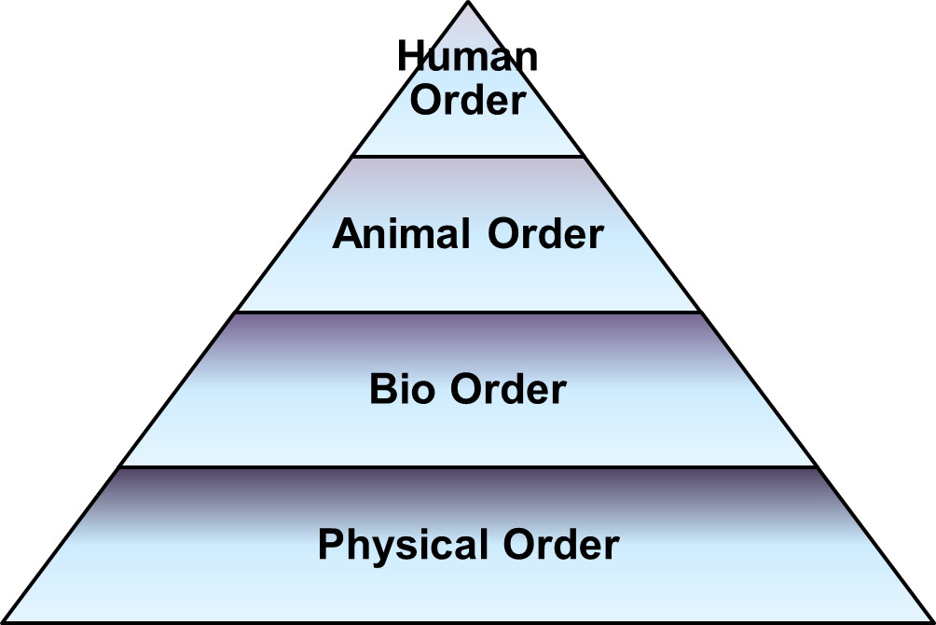
Harmony in Nature iz—fr esa O;oLFkk
Nature is organised in such a manner that the physical facility required for any order is available in abundance*
Dependence of any order is on all previous orders
e.g. Bio order is dependent on physical order
e.g. Human order needs the most conducive
environment. Human order depends on
animal order, bio order as well as
physical order
Quantity of units
Physical >> Bio >> Animal >> Human
*Need of physical facility is limited
Availability is also limited but in
A quantity much larger than need

Slide 19
Harmony in Nature iz—fr esa O;oLFkk
All orders have definite conduct except human order without right understanding
In human being, the body has definite conduct
The Self (I) operating on assuming without knowing is the source of indefiniteness, problem
The solution is to ensure knowing
The natural acceptance is to know,
to be in harmony
For this,
human education-sanskar
Is required

Slide 20
Sum Up
Physical order – soil, metals etc.
Bio order – trees, plants etc.
Animal order – animals, birds etc.
Human order – human beings
There is a relationship of mutual fulfilment (harmony) amongst these 4 orders. The first 3 orders are mutually fulfilling for each other. They are fulfilling for human being also. It is naturally acceptable to human beings to be fulfilling for all the orders
The role of human being is to realize this mutual fulfilment – For this, all that human beings need to do is:
  To understand that mutual fulfilment (harmony) is inherent in nature – we do not have to create it
  To live accordingly – then the mutual fulfilment amongst the 4 orders will be realised
and there is provision in nature for living with mutual fulfilment (harmony)
Nature = Collection of Units
= 4 Orders
Relationship of mutual fulfilment (harmony)

Slide 21
Self Reflection

Slide 22
Self Reflection
What are your assumptions about nature? Is it for human enjoyment or does human being have a role to play for harmony in nature?
In a typical day, how much time do you interact with physical order, bio order, animal order and human order? What is that interaction (taking, giving, appreciating, fulfilling a responsibility…)
How do you and your family contribute to / participate in maintaining the order (harmony) in nature?
Can you see that units of the physical order, bio order and animal order have a definite conduct? Can you see that if the conduct of a human being is in accordance with their natural acceptance, then it will be definite (because the natural acceptance is definite)?

Slide 23
Questions?

Slide 24
FAQ
We are told that every living and non-living thing has life (soul). Here you are saying that only human order and animal order has self. So how can we find out if there is a self or not in any unit?
So are activities like bio engineering, GMO inhuman?
In nature the first three orders are already having definite conduct. Why does human order have to work for definite conduct? I mean why is that also not automatic or natural?
Is solely education responsible for the conduct? Are there any other factors?
In nature we can see that there is survival of the fittest. So doesn’t it apply to human beings also?
Are the problems like global warming a result of human activities only?

Slide 25
Nature iz—fr
Nature iz—fr = Collection of Units bdkbZ lewg
Unit = Activity = In the form of individual unit
4 Orders
Relationship of Mutual Fulfilment
Material
tM+
Consciousness
pSrU;

Slide 26
Nature = Collection of Units = 4 Orders
The presence of Self (I) is
indicated by the presence
of the activity of Assuming
To understand the other three orders, right understanding of the Human Order is required,
otherwise over-evaluation, under-evaluation or otherwise-evaluation of the other orders keeps taking place.
Recognizing, Fulfilling
Bio Order
Plants, Trees
izk.k voLFkk
isM+] ikS/ks
Assuming,
Recognizing, Fulfilling
Recognizing, Fulfilling
Physical Order
Soil, Metal
inkFkZ voLFkk
feV~Vh] /kkrq
Animal Order
Animals, Birds
tho voLFkk
i”kq+] i{kh
Self (I) +
Body
Human Order
Human Being
Kku voLFkk
euq’;
Assuming,
Recognizing, Fulfilling
Potential for Knowing, Assuming,
Recognizing, Fulfilling
Self (I) + Body

